Slide 1



Medical AI Reviewer
Reads the record, retrieves the evidence for each claim item, flags discrepancies, and returns a cited summary — every line traceable to a page.
Created by Shirisha Dhannini & Kapil Suthraye

Slide 2

MEET THE HUMAN REVIEWER BURIED UNDER A THOUSAND PAGES OF DATA
A CLINICAL REVIEWER’S WORLD IS A STACK OF ENDLESS PAGES, EACH ONE DEMANDING CAREFUL ATTENTION. THIS IS THE MANUAL MOUNTAIN.

Slide 3

IT IS 04:00 AM, AND MANUAL HUMAN READING SIMPLY CANNOT SCALE AGAINST THE BACKLOG
IT’S 4:00 AM. HER SHIFT HAS BEEN NONSTOP, YET ONLY FEW CLAIMS ARE DONE. THE CLOCK RUNS OUT, BUT THE BACKLOG DOESN’T.

Slide 4
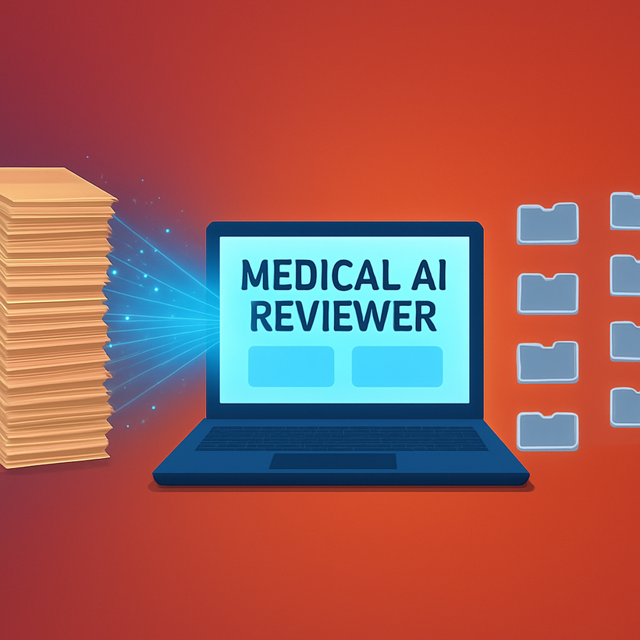
INTRODUCING MEDICAL AI REVIEWER — KEEPING HUMAN INSIGHT WHILE REMOVING THE LONG SEARCH.
SO WE ASKED: WHAT IF READING THE WHOLE RECORD WASN’T ON THE NURSE’S PLATE?
MEDICAL AI REVIEWER ABSORBS IT ALL, HIGHLIGHTS WHAT MATTERS, AND DELIVERS A CLEAN, CITED SUMMARY.

Slide 5

A 70% FASTER WORKFLOW WRAPS THE ENTIRE BACKLOG BY 04:00 PM.
FIVE CLAIMS A DAY BECOMES FIFTEEN. A 70% QUICKER REVIEW FLOW GIVES HER TIME BACK FOR REAL DECISIONS.

Slide 6



Thank You

